Slide 1
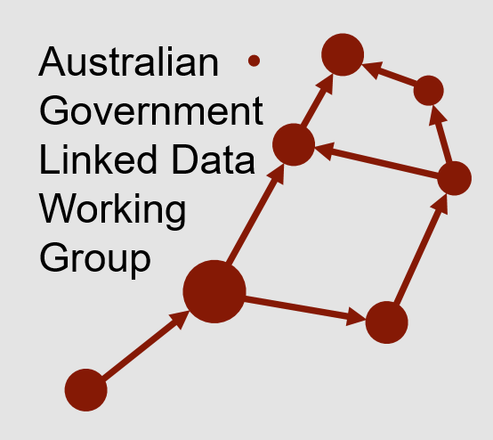
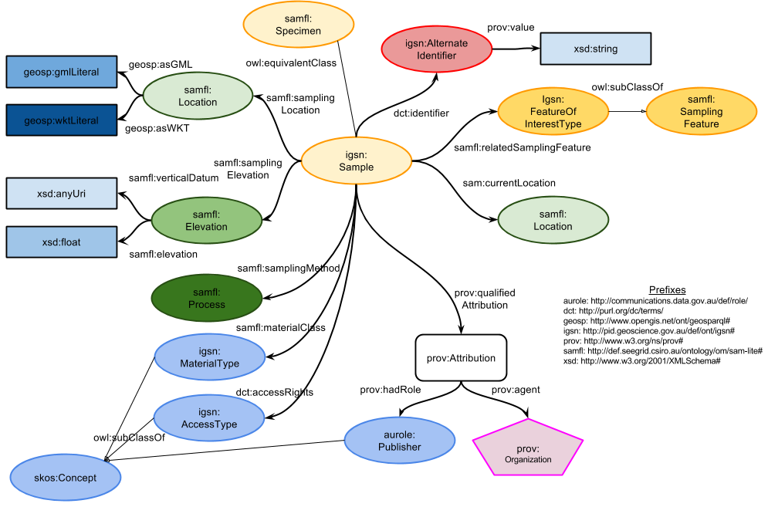

Whole-of-government data integration using Linked Data
Nicholas Car
Co-Chair AGLDWG, Senior Experimental Scientist, CSIRO

Slide 2














Australian Government Linked Data WG
Community of Commonwealth Government experts and champions, with invited non-voting participation of individuals, corporations and other entities.
Established in August 2012, with strong growth in membership since the Government released the outcomes of an inquiry on Data Availability and Use in the Australian Government.
No official Government mandate or related legislation, but a community of practice that promotes and represents a series of federal Government entities who seek to implement and use Linked Data technologies for the betterment of Australian Government data sharing.
Several members have signed an MoU to support the use and persistence of linked.data.gov.au URIs.

Slide 3
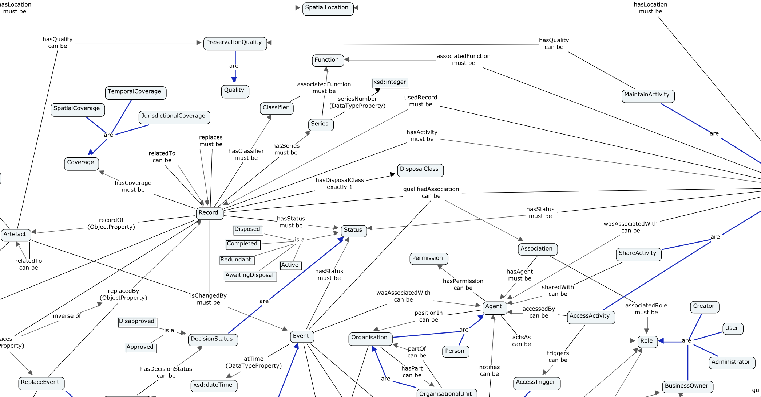
Outline
The Aust Govt Linked Data WG
Things the AGLDWG does
Aust Govt Integrated Set of Ontologies
Domain-specific integration
Earth sciences integration

Slide 4
Australian Government Linked Data WG
Community of Commonwealth Government experts and champions, with invited non-voting participation of individuals, corporations and other entities.
Established in August 2012, with strong growth in membership since the Government released the outcomes of an inquiry on Data Availability and Use in the Australian Government.
No official Government mandate or related legislation, but a community of practice that promotes and represents a series of federal Government entities who seek to implement and use Linked Data technologies for the betterment of Australian Government data sharing.
Several members have signed an MoU to support the use and persistence of linked.data.gov.au URIs.
May change soon!

Slide 5
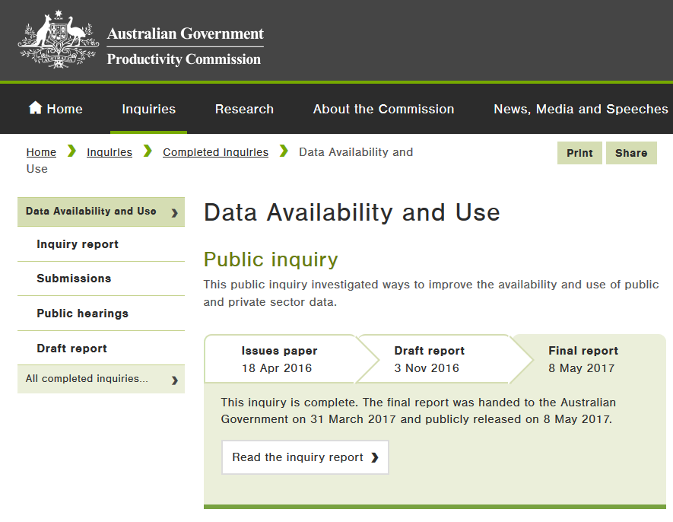
Things the AGLDWG Does
Facilitate the LD community
Engage with WoG data initatives
Manage linked.data.gov.au namespace
and provide Guidelines for it’s use
Starting to register Linked Data resources
Datasets
Ontologies
Others…
Propose AGISO…

Slide 6

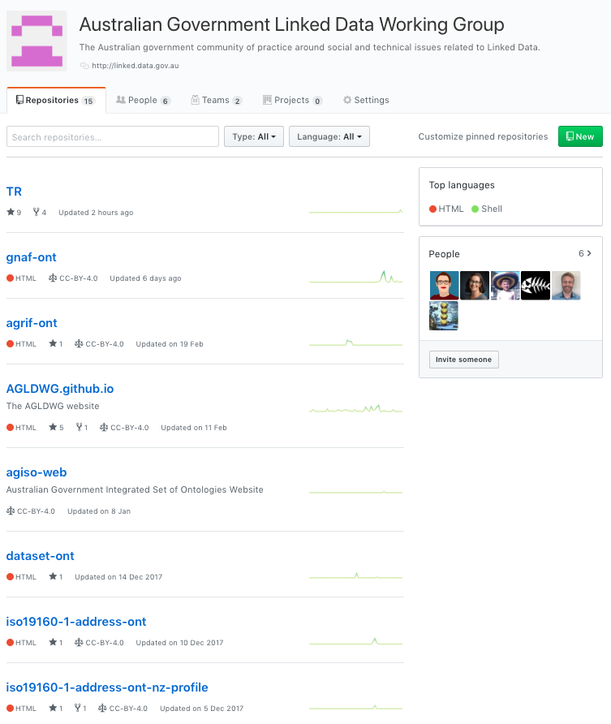
AGLDWG Web Presence
http://linked.data.gov.au
https://github.com/AGLDWG

Slide 7
Aust Govt Integrated Set of Ontologies (AGISO)
The WG is in the process of developing a proposal for an integrated set of ontologies
Currently, there are several ontologies (e.g. Dataset ontology, AGRIF) being developed with a ‘whole of government’ focus
AGISO aims to integrate these and future ontologies allowing them to be used individually or collectively in a seamless way: as if they were one data model
In making this proposal, the AGLDWG steps beyond international precedent regarding government Linked Data initiatives, in that we intend to provide semantic modelling resources and governance, not just guidelines and recommendations for Linked Data publication

Slide 8
AGISO cont.
Expected methods
A new ontology is submitted:
Proponent should model with AGISO in mind
Proponent must present the ontology to an association testing tool
AT Tool will indicate how, if at all, the ontology’s elements link to the existing AGISO ontologies
Tool assists, but does not complete, compliance processes: links made will be indicative only, human oversight needed
Unlinked classes especially scrutinised to determine reason for non-linking (non-reuse)
WG publishes ontology into AGISO if satisfied with level of reuse

Slide 9
AGISO cont. – LOC-I
First implementation test in LOC-I project, July 2018+
Some parts of AGISO will be tested as a series of integrated ontologies will be made for the LOC-I (Location Integrator) Linked Data project is undertaken
LOC-I:
path association
path association
Govt. Data
Business Data
Enviro Data
spatial association
spatial association
spatial association
Geofabric
G-NAF
Adm Bnds
AGISO spatial datasets
AGISO association
+ PN Gaz?

Slide 10
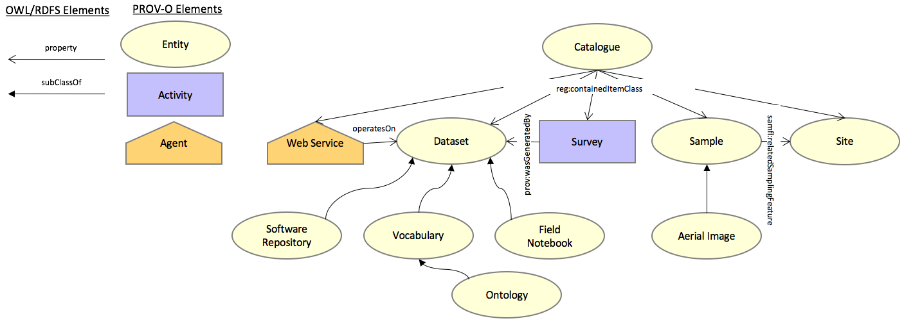
Domain-Specific Integration
Where a domain can be more tightly coupled than AGISO, Semantic Web Modelling can assist with ‘upper ontologies’ and Linked Data can assist with getting the data out.
GA’s own Public Data Model
http://pid.geoscience.gov.au/def/ont/ga/pdm

Slide 11
Domain-Specific Integration cont.
FSDF Ontology
The spatial bit in LOC-I & AGISO
Geofabric
G-NAF
Adm Bnds
:Address
:Mesh Block
gnaf:hasMeshBlockMatch
e.g. http://gnafld.net/address/ GAACT714857880
:Catch-ment
?
?

Slide 12
Domain-Specific Integration cont.
FSDF Ontology
The spatial bit in LOC-I & AGISO
Get to the rocks!
Geofabric
G-NAF
Adm Bnds
:Address
:Mesh Block
gnaf:hasMeshBlockMatch
e.g. http://gnafld.net/address/ GAACT714857880
:Catch-ment
?
?

Slide 13
LD Data Integration in Earth Sciences
?
AODN Geographic Extents
DGGS
coastline
?
Nat. Data Catalogues
Geofabric
Statistical Geography
publisher
Au Orgs
(starting July)
wasDerivedFrom
spatial overlay possible
publisher
ACLUMP
GA/National Samples
GA Sites
NEII Sites
sample at
subset
location?

Slide 14
Questions?
Contacts
AGLDWG: http://linked.data.gov.au
AGISO: coming!
Nick: nicholas.car@csiro.au

